Slide 1

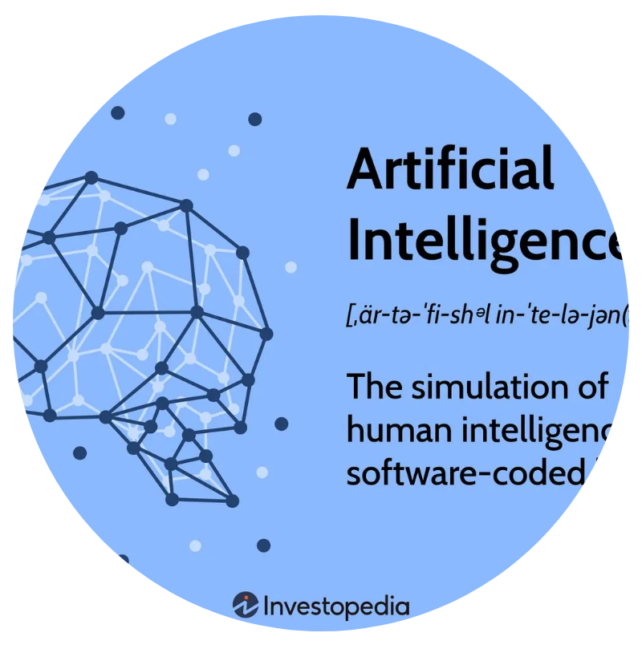
Advanced AI-Powered Content Analysis Suite
Transforming Information Overload into Actionable Insights
July 2025

Slide 2


Introduction & Problem Statement
Information overload
in the digital age has created an
environment where accessing information is easy, but
extracting meaningful insights is arduous.
Traditional
manual summarization
methods are:
• Time-intensive and labor-consuming
• Prone to subjectivity and inconsistency
• Fundamentally unscalable to vast quantities of data
• Challenging for knowledge retrieval
There is a critical gap between
information availability
and the human capacity to effectively process,
understand, and leverage it.
Advanced
AI and NLP technologies
offer a
transformative solution to automate and streamline the
summarization process at unprecedented scale and
speed.

Slide 3






Project Overview & Vision
Background & Motivation
The exponential growth of digital content has created an urgent need for intelligent tools that can process, analyze, and distill information efficiently.
Problem Statement
Existing methods for note-taking and content digestion are
time-
intensive
, prone to
human error
, and fundamentally
unscalable
to the
vast quantities of digital data encountered daily.
Project Objectives
Develop an intuitive, user-friendly web interface
Implement advanced AI-powered summarization engine
Enable multi-format content processing
Provide customizable analysis options
Expected Outcomes
A fully operational web application capable of accurately summarizing diverse content, demonstrating superior accuracy and coherence across different audience profiles.

Slide 4


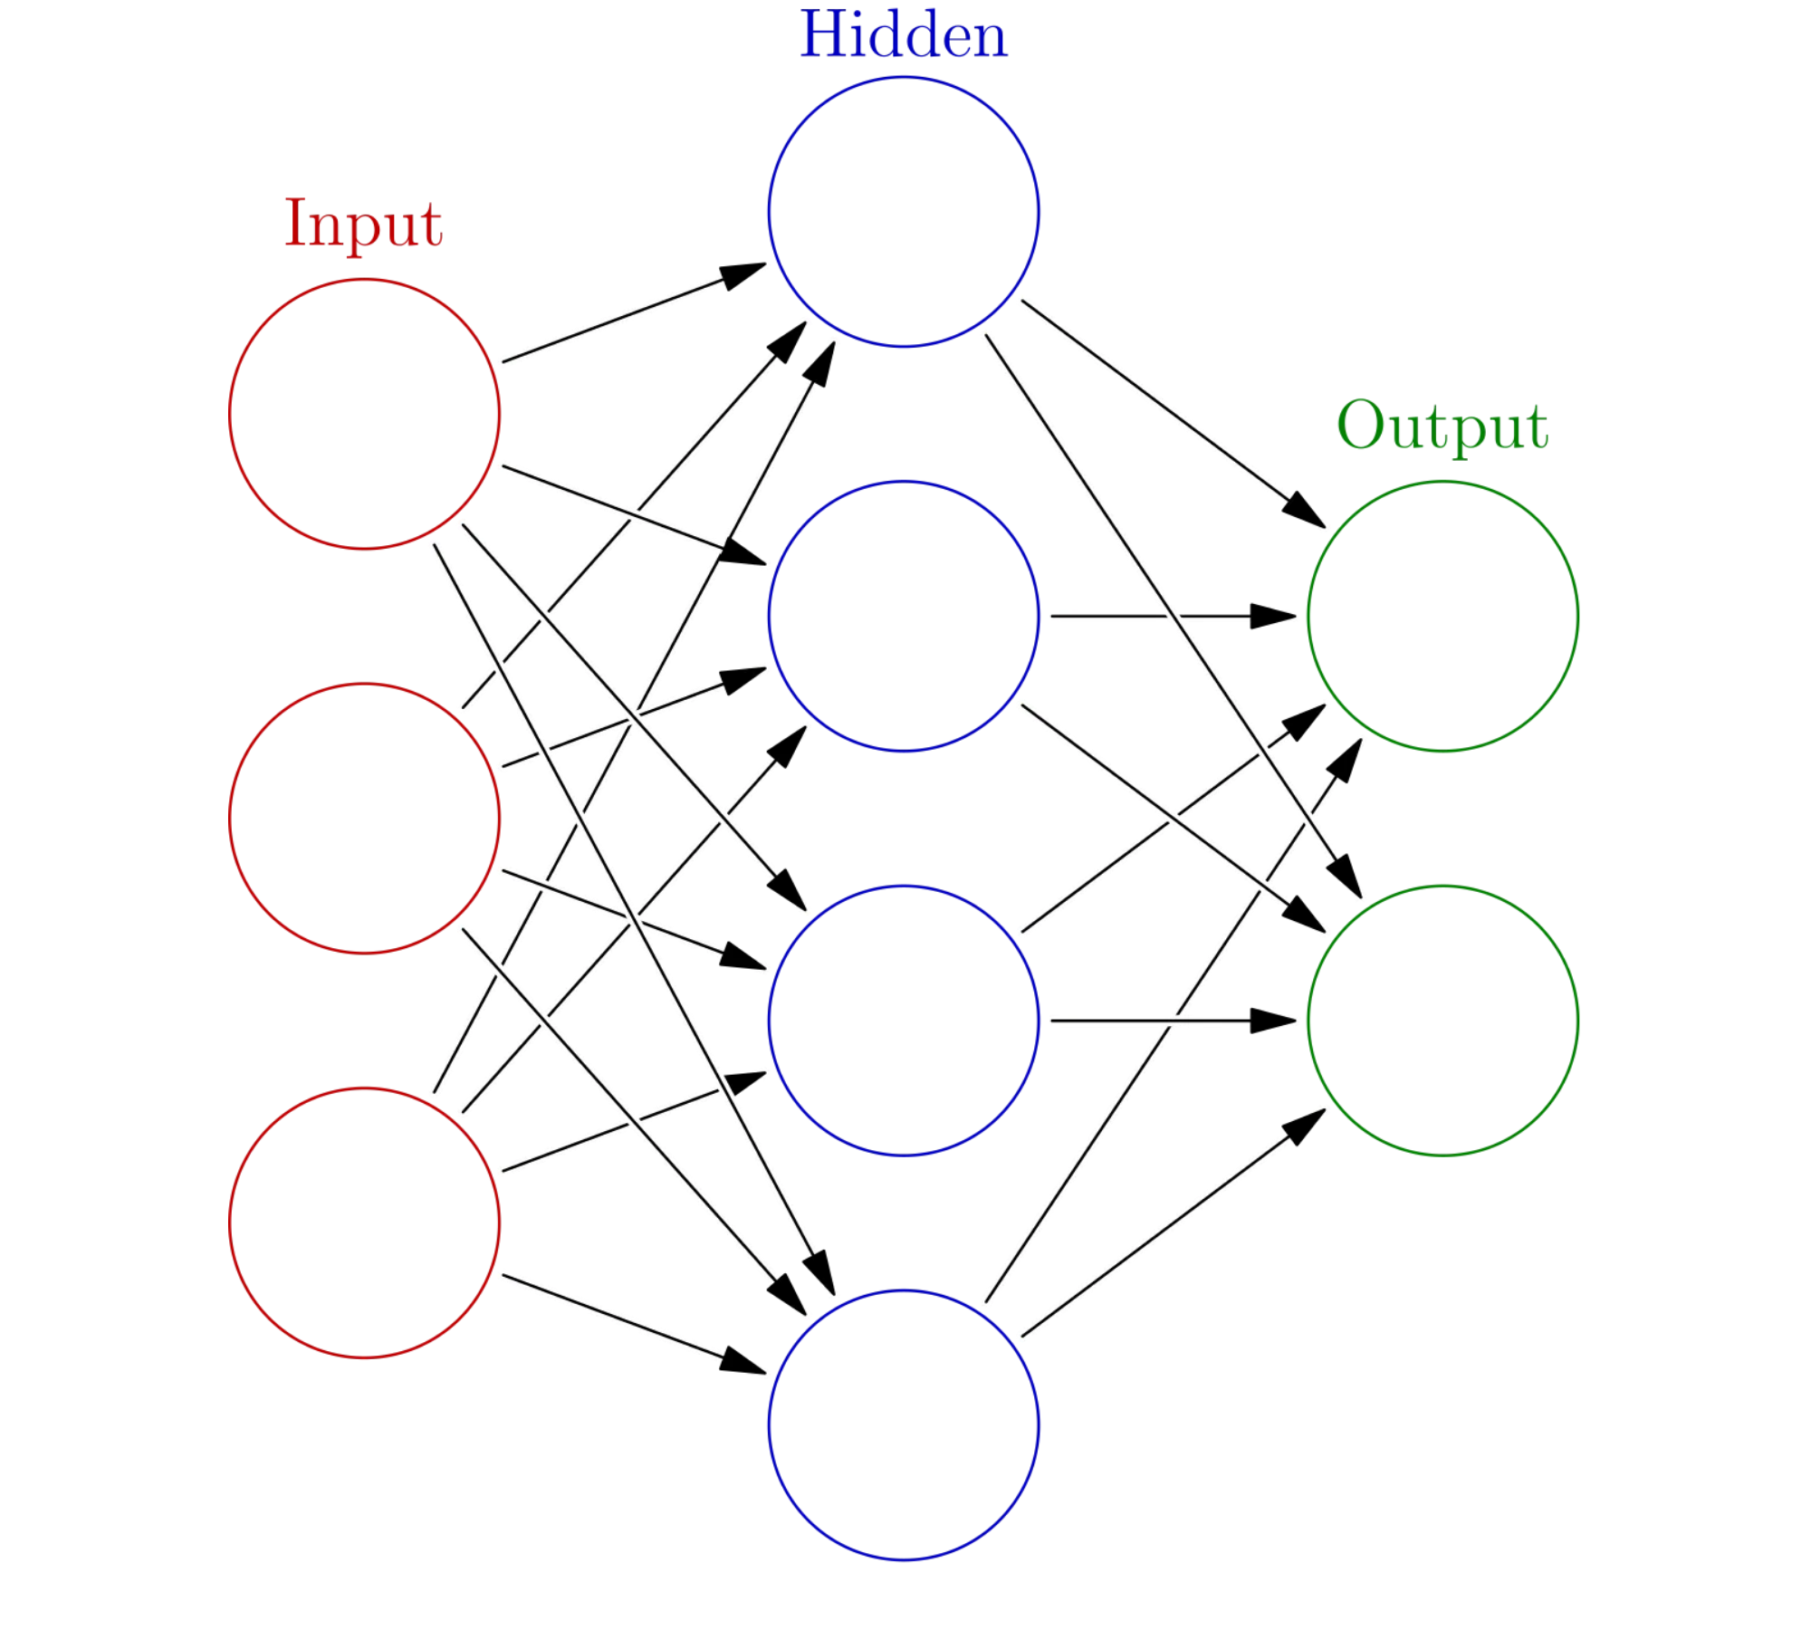




Foundational Technologies
Natural Language Processing
Core NLP concepts including tokenization, part-of-speech tagging, named entity recognition, and dependency parsing enable text understanding.
Transformer Networks
Self-attention mechanisms allow models to weigh the importance of different words in context, revolutionizing sequence-to-sequence tasks.
State-of-the-Art Models
T5:
Text-to-Text Transfer Transformer for general summarization
BERT:
Bidirectional Encoder for semantic keyword extraction
BART:
Bidirectional Auto-Regressive Transformer for child-friendly summaries
Audio Processing
OpenAI's Whisper model enables robust speech-to-text transcription from audio and video content.
Supporting Libraries
Streamlit, ReportLab, Plotly, BeautifulSoup, NLTK, spaCy, and gTTS provide essential functionality.

Slide 5




System Architecture
Multi-Layered Architecture
Input Layer: Content Ingestion
The Advanced AI-Powered Content Analysis Suite is engineered with a
modular and scalable
architecture, designed to efficiently process diverse
content types.
Text Input
Document Upload
Media Upload
Web URL
Input Layer:
Handles diverse content ingestion (text, documents, media, URLs)
Processing Layer: AI/NLP Engine
Processing Layer:
Core AI/NLP engine with model orchestration
T5 Model
BERT Model
BART Model
Whisper Model
spaCy
Output Layer:
Presents insights through UI, reports, and visualizations
Model Integration
The system intelligently orchestrates multiple specialized AI models:
Summaries
Keywords
Study Materials
Visualizations
PDF Reports
T5:
Primary model for audience-specific summarization
Output Layer: Structured Information & Visualizations
BERT:
Generates contextual embeddings for keyword extraction
BART:
Specialized for child-friendly summaries
Whisper:
Handles speech-to-text transcription
Data Flow & Security
The system processes user-provided content without persistent storage of sensitive information. All uploaded files and pasted text are processed in memory or as temporary files, and are promptly removed after processing.

Slide 6

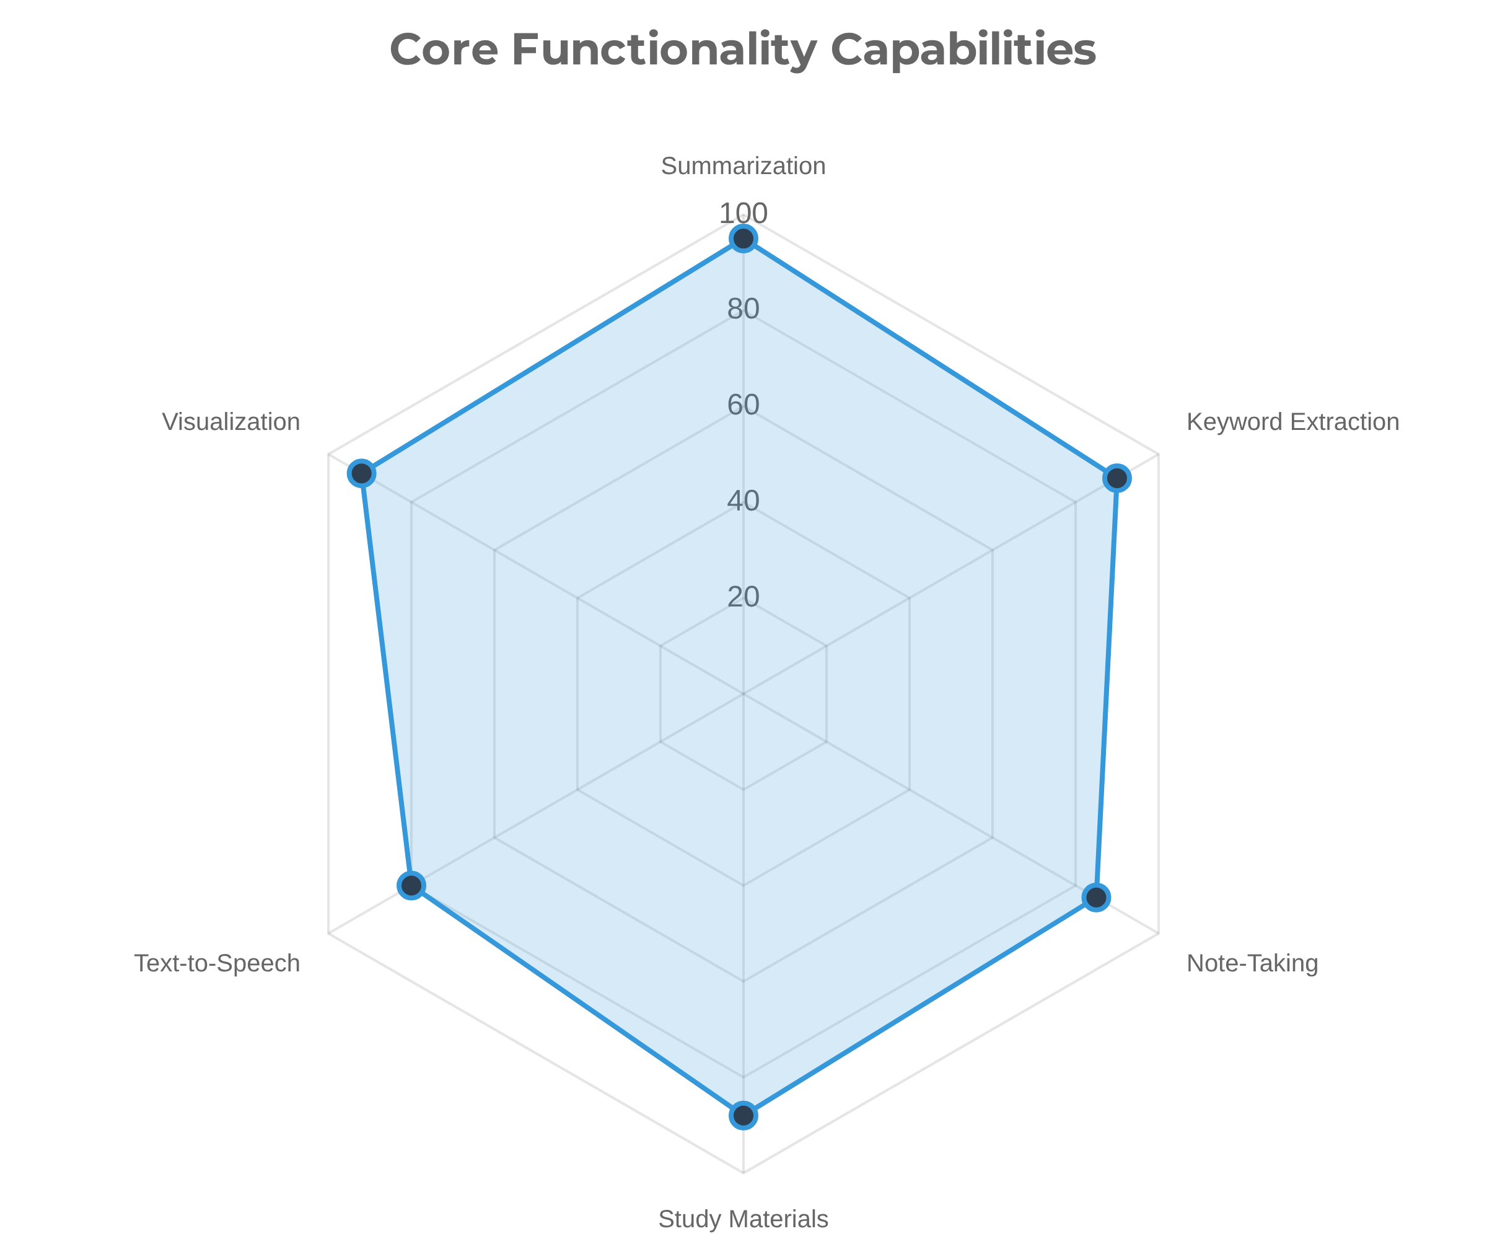





Core Functionalities
Audience-Specific Summarization
Generates tailored summaries for
students
,
researchers
,
experts
,
and
children
, adapting content complexity and focus to the chosen
audience.
Semantic Keyword Extraction
Identifies and ranks key terms and phrases, providing contextual meanings and relevance scores based on advanced BERT embeddings.
Diverse Note-Taking Formats
Automatically structures information into Cornell notes, mind map outlines, and linear notes, facilitating organized knowledge capture.
Study Materials Generation
Creates flashcards, practice questions, and suggests various diagram types to aid learning and retention.
Text-to-Speech Playback
Offers an audio version of generated summaries, enhancing accessibility and convenience.

Slide 7


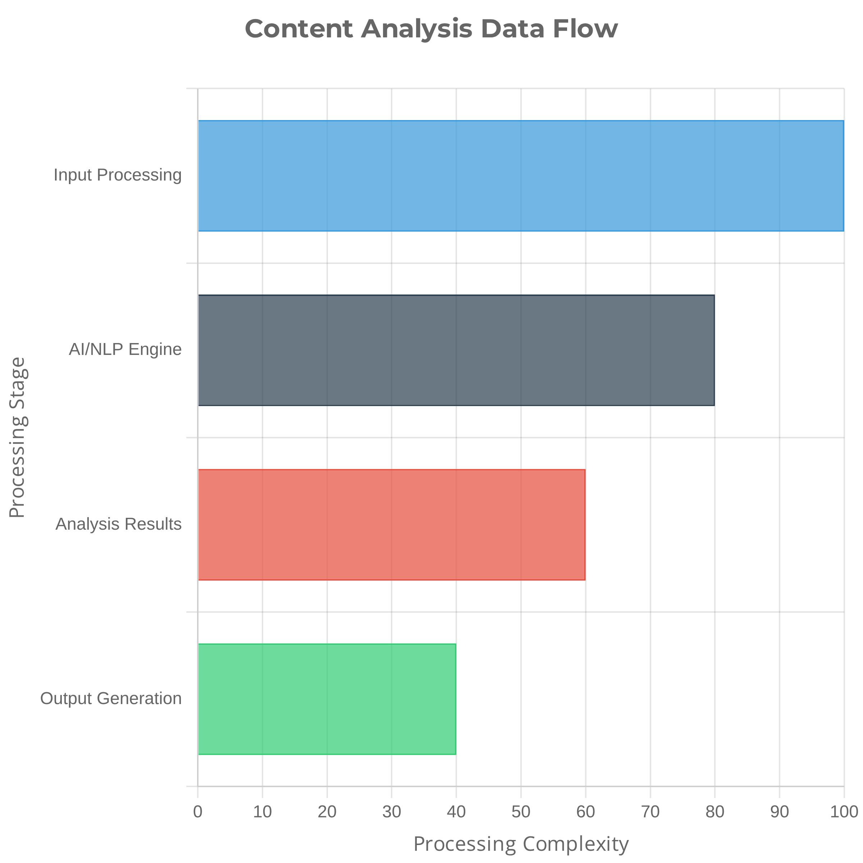










Input & Output Management
Input Modalities
Direct Text Input
Paste or type any textual content directly
Document Upload
PDF, DOCX, PPTX, TXT formats supported
Media File Upload
MP3, WAV, MP4, MOV, AVI, MPEG with audio extraction
Web URL Content
Web pages and YouTube transcripts
Output Formats
On-Screen Display
Interactive UI with tabs, expanders, and content cards
PDF Report Generation
Professional, structured reports with all analysis results
CSV Export for Keywords
Downloadable data for further analysis
Audio Playback
Text-to-speech for generated summaries

Slide 8




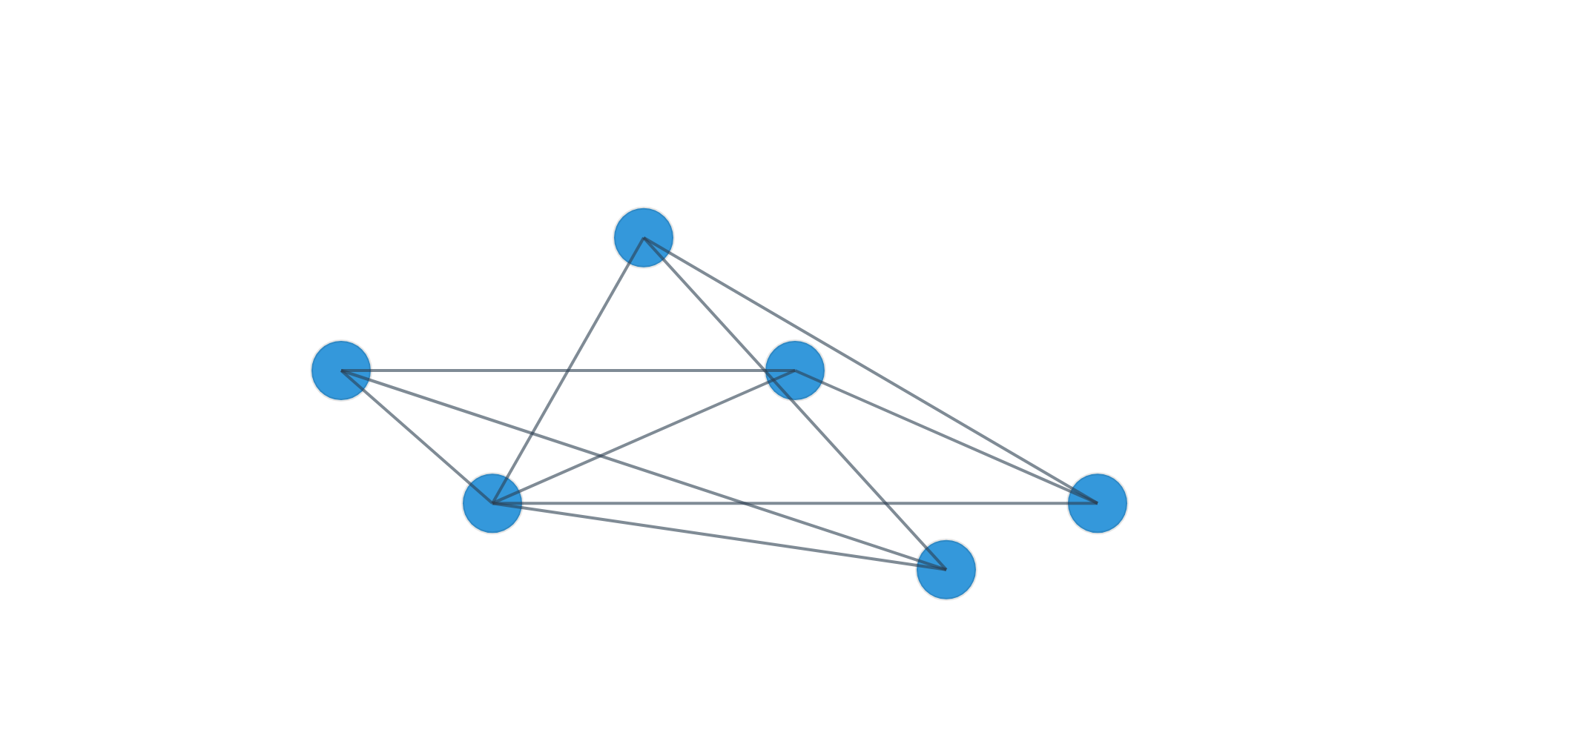

Visualizations & Insights
Word Cloud Generation
Entity Co-occurrence Network
Visual representation of text data where the size of each word indicates its frequency or importance in the analyzed content. Provides immediate thematic overview and keyword identification.
Interactive visualization illustrating relationships between key entities (persons, organizations, locations, concepts) within the analyzed text. Helps understand connections and frequently co-occurring elements.
Benefits of Visual Analytics
Transforms complex textual data into intuitive graphical formats
Supports interactive exploration of data connections
Enables quick identification of key themes and relationships
Complements textual analysis with spatial understanding
Enhances pattern recognition and insight discovery
Improves retention and comprehension of complex information

Slide 9


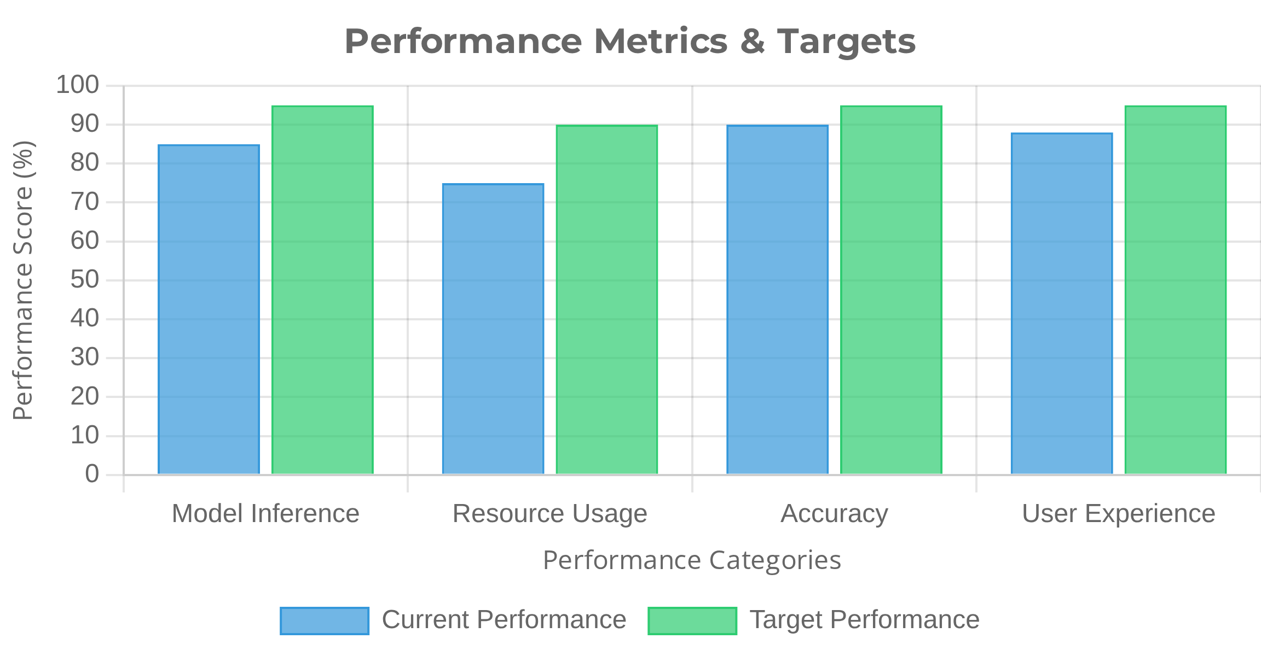





Conclusion & Future Directions
Key Achievements
Performance Considerations
Successfully developed an
AI-powered web application
that
transforms information overload into actionable insights
Implemented
audience-specific summarization
that adapts
content complexity to different user needs
Created comprehensive
study materials generation
capabilities
to enhance learning and knowledge retention
Current Limitations
Challenges with very long texts and maintaining global coherence across chunks
Future Enhancements
Integration of more specialized domain models for technical fields
Nuances in child-friendly summaries require further refinement
Enhanced multilingual support for global accessibility
Improved hierarchical summarization for very long documents
Development of collaborative features for team-based analysis

